Slide 1
.
Our Approach
At Quest Food Management Services, we have been providing fresh, high-quality food and intensely personal service for over 35 years. Our Food Philosophy guides our approach to wholesome, scratch-made food, and our culinary leaders deliver tailored dining experiences to the unique needs of each community we serve. Driven by our unparalleled responsiveness to feedback, we crave being challenged to think outside of the box.
These values have made us one of the fastest growing companies in our industry. With a full spectrum of innovative, inspiring experiences to offer, we are a trusted partner to some of the Midwest’s most notable institutions and organizations.
To learn more about Quest, please visit our corporate website at www.questfms.com
Contact Us
Food Service Director: Shannon Lauridsen
Email: jca@questfms.com
Kitchen Phone: 815-741-0500 EX243
Hours of Operation: 10:20am-12:30pm
Meet Your Dining Services Team!
Shannon Lauridsen
Food Service Director
jca@questfms.com
815-741-5100 EX243
QUEST FOOD SERVICE TEAM MEMBERS:
Joan Chamberlin
Diane Midlock
Daina Kensella
Joe Midlock

Slide 2
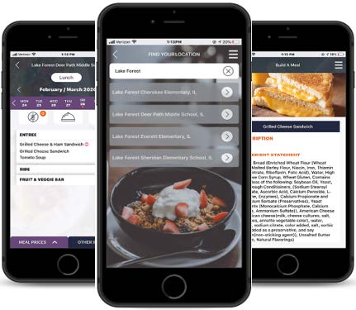
Don’t Miss a Bite – Download the Menu App
Download the Menu App @ www.FDMealPlanner.com or download the free “FD MealPlanner” app from the App Store (iOS devices) or Google Play Store (for Android devices).
For location type in Joliet Catholic Academy. View announcements and see what's “cooking” in your café! View ingredients and nutrition information for all menu items. The app provides real time data and is the perfect way to stay up to date on what is being served in your cafeteria.
Link to Instructional Video
Monthly Menu PDF (don’t forget to download the print version of the monthly menu so it is accessible with just a click!
Adding Funds
Mealtime is a user-friendly school food service software system, providing fast, friendly customer service that helps your student get through the line quickly. Mealtime allows you to add funds, receive notifications, and view balances and purchases. This is for Secondary students, staff, faculty and parents, you can use this for any additional snacks, breakfast and beverages.
Sign up today at https://www.mymealtime.com/

Slide 3
Quest Allergen Disclaimer
Due to the handcrafted nature of our menu items, our kitchens which share cooking and preparation areas, and our reliance on suppliers for accurate information, we cannot eliminate the risk of cross-contact or guarantee that any item is free of any allergen. There is a possibility that suppliers of the commercial foods we use can change the formulation or substitute ingredients at any time, without notice. To that end, we make every attempt to identify ingredients and menu items that contain the 8 major allergens (milk, eggs, soybeans, fish, crustacean shellfish, wheat, peanuts, tree nuts). The allergen information provided is up-to-date to the best of our knowledge and is based entirely on the information provided by our suppliers. We also make every effort to instruct our food production staff on the severity of food allergies.
The Quest Dining Team and Joliet Catholic Academy consults individually with customers whom have food allergies to minimize allergic reactions. Prior to consuming menu items, individuals with life-threatening food allergies should confirm the ingredient information on the actual label of the product. If a customer decides that the menu item is safe on any given day, that decision is entirely their responsibility. Joliet Catholic Academy will not assume any liability for adverse reactions to foods consumed, or items one may come in contact with while eating at Joliet Catholic Academy No allergen information should ever be considered a guarantee, but simply a best faith effort to serve our customers.
Customers with food allergies are encouraged to contact Food Service Director, Shannon Lauridsen at jca@questfms.com here or 312-471-1215 for additional information and/or support.

Slide 4
Our Food Philosophy
We are passionate about food and we believe in wholesome, nutritious ingredients. That is why we are committed to using items healthier for both our bodies and the planet. By purchasing with the following standards in mind and preparing items so that they are as fresh as possible when served, we support local agriculture, increase nutrition, and intensify flavor.
Never using artificial trans-fats for any items prepared in house.
Never using MSG.
Serving produce that is fresh, fresh frozen or packed in 100% juice or water.
Sourcing milk that is local and free of added growth hormones.
Serving 100% cage-free eggs.
Offering 100% produced at origin, hand harvested, mountain grown, custom-blended coffees. Supporting partnerships with the Colombia Coffee Growers Association, Rainforest Trust, and numerous charities through Fundraising 365.
Serving proteins that are USDA certified.
Purchasing sustainable seafood that follows the Marine Stewardship Council’s guidelines and recommendations.
Writing menus that feature seasonal and regional products we source from local farmers and small producers.
Accommodating nutritional and dietary requests.
Offering a wide variety of vegetarian, vegan and gluten-free options.
Serving an array of whole grain breads, pastas and cereals.
Our Mission, Vision, and Values
Mission: Quest provides the communities we serve with fresh, high-quality food, exceptional responsiveness and intensely personal service.
Vision: We are committed to creating the most enduring relationships in the industry by what we do and how we do it.
Values: Integrity, Responsiveness, Accountability, Respect, Excellence

Slide 5
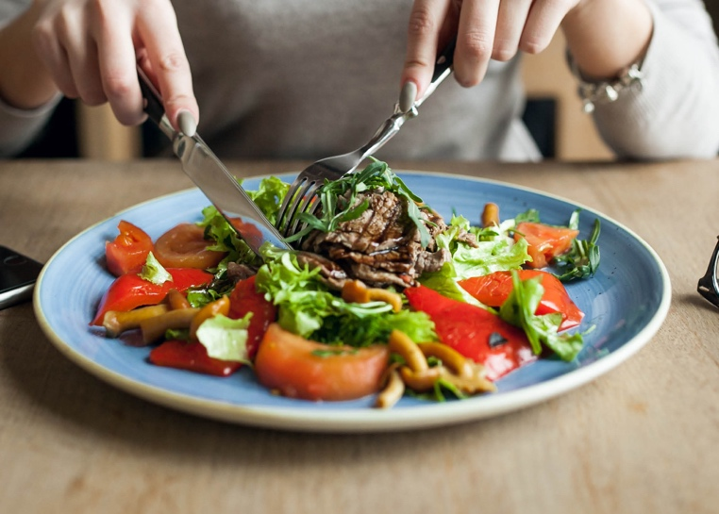
Wholesome Meals
Quest is committed to offering a variety of healthful options. All of our meals feature lean proteins, whole grains, healthy fats, and a wide variety of fruits and vegetables.
Sourcing Locally
We utilize programs that help us source from farmers and artisans within 250 miles of your school. These programs provide access to the highest-quality produce and specialty foods that we get to offer in our dining hall.

Slide 6
Our Food Concept Stations
Bread & Bowl
Bread & Bowl features Made-to-order deli sandwiches, paninis, and homemade soups and breads. All of our sandwiches and wraps include options for students that are gluten-free. We top these options with high-quality meats and cheeses, fresh produce, and garnish with traditional and gourmet condiments.
Good Greens
Good Greens features fresh leafy greens with a variety of colorful fruit and vegetable toppings. In addition, guests can find a variety of composed salads with animal and plant-based proteins with a variety of dressings. Our in-season and locally-sourced options make for a great foundation of our salad bar and fresh produce concept.

Slide 7
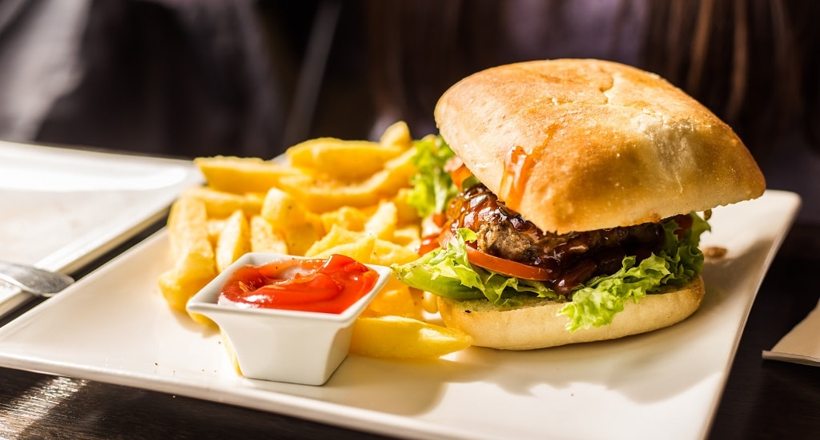
Picante
Picante is our made-to-order authentic Mexican concept station. We offer proteins seasoned and roasted in-house, and salsas made from scratch.
Grill
Burgers, chicken sandwiches, and sliders are all favorites off of the grill. We offer those as well as enhanced versions of traditional favorites. Featuring lean 100% beef, turkey, and vegetarian options, the Grill offers something for everyone.
Crust
Pizza is a staple for any school dining program. With traditional hand-tossed favorites, gourmet thin crust options, gluten-free options, calzones, and everything in between – The Crust offers more than just pizza.

Slide 8
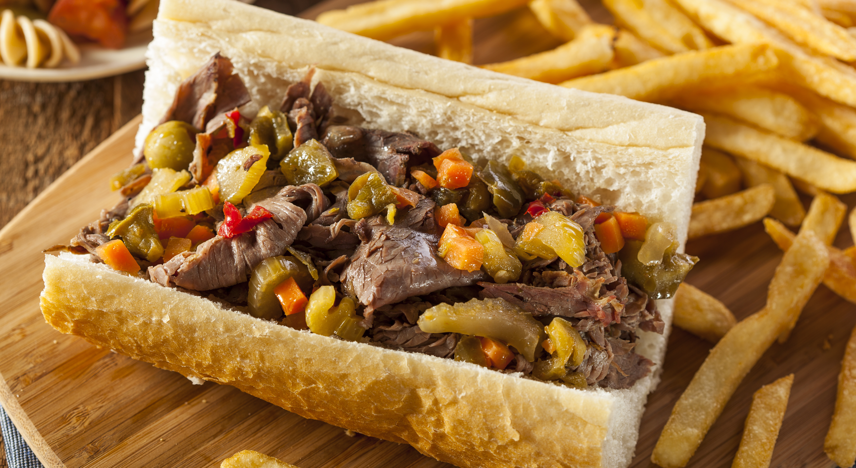
Dash
We understand that classes, work, and athletics can make a student’s already busy schedule even busier. That's why Dash provides a variety of hot and cold grab & go items such as yogurt parfaits, protein boxes, sandwiches and wraps, and much more.
Homegrown
Homegrown features the unique flavors, ingredients, and traditions found in regional, American cuisine. Guests can find a rotating menu of Chicago staples; Kansas City, Memphis, and Texas BBQ; New England seafood classics; Carolina low-country fare; and the fresh, produce-centered favorites from Southern California.
Crave
Nothing compliments a great dining experience like a sweet finish to a delicious meal. Our dessert offerings will feature made-from-scratch, baked in-house items that are portable.

Slide 9
Note: this image can also be used to post to the school’s social media sites or your Quest Social Media Site if applicable.
Quest is hiring
Quest is looking for (insert positions here) to join the team. For more information and to apply online visit: www.questfms.com/careers

